Slide 1
Croatian Open Access journals peer review guidelines and policies
PEERE Meeting on „Taking Stock of Peer Review” & 2nd Workshop on Simulating the Social Processes of Science (SSPOS II), Valencia, Spain, 8-11 March 2016
Jadranka Stojanovski
University of Zadar / Ruđer Bošković Institute

Slide 2
Goals
Transparency of editorial policies on peer review
How editorials are approaching and guiding peer reviewers?
What types of documents are related to the peer review?
From present content towards future comprehensive guidelines

Slide 3
Peer reviewer roles
Provide feedback to authors to improve the quality of their manuscript
Provide feedback to the editor to improve the quality of the journal
Improve the quality of scholarly publication in the discipline
The Journal of the American Osteopathic Association (JAOA)

Slide 4
Instructions for peer reviewers
author – to know details about peer review process
reviewer - to make clear what makes a good review, to help reviewers understand what matters to editors, to give reviewers help in producing a good review, to make clear what is expected from reviewer in terms of journal quality standards
readers - may have more confidence on objective and unbiased peer review, and consequently more trust in the accuracy of the published research studies

Slide 5
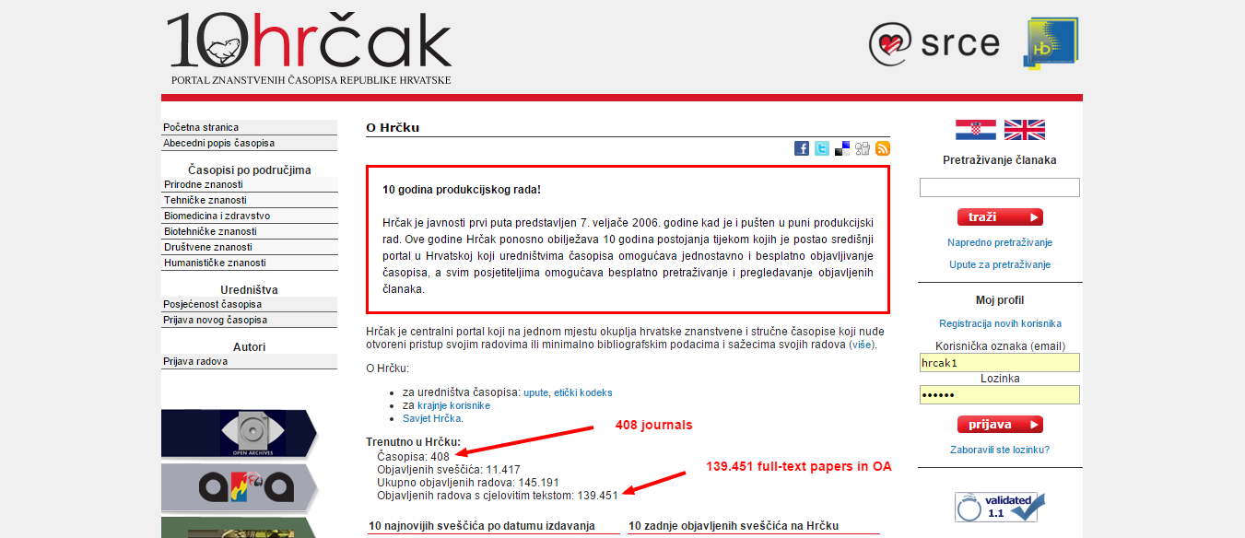

Slide 7
Methodology
408 Croatian OA journals
145 (+7) documents on peer review (PDF, DOC, RTF, TXT)
English and Croatian language
Text analysis
Document as an unit (case)
Automatic coding using non-validated categorization dictionary
Provalis Research software for text analysis (QDA Miner and WordStat for word frequency analysis and text mining)

Slide 8
Instructions for peer reviewers
after removing duplicates, and checking journal web sites, we collected final number of 152 documents
58 documents just mentioning peer review
63 documents are forms (57 readable for QDA Miner)
31 documents are instructions for peer reviewers

Slide 9
Not instructions for peer reviewers (58)
Peer Review Process
Original scientific papers submitted for publication are reviewed by two referees. Authors are requested to provide names and contact information (e-mail address) of two experts in the field as possible reviewers of their manuscript. Only papers with favorable reports are accepted for publication. The revised manuscript should be returned within three months. The acceptance of manuscripts for publication is decided by the Editor-in-Chief.

Slide 10
Instructions Forms
Notes:
This time I will not comment on the form which is ment to be printed, filled by hand, scanned and sent back to the editors.

Slide 11
WHAT EDITORS EXPECT FROM PEER REVIEVERS?
Reviewing journal manuscript by Charon A. Pierson (Wiley-Blackwell)

Slide 12
Before reviewing
Does the article match reviewer’s expertise?
Does reviewer have time to review the paper?
Are there any potential conflicts of interests?

Slide 13
Reviewer should take care about:
Appropriate citation of material
Clarity of writing
Logical progression of content
Synthesis of sources
Spotting plagiarism
Journal style and reference format

Slide 14
Conflict of interest disclosures
author
reviewer

Slide 15
Review (applicability depends on the discipline)
Fit with the journal’s mission and target audience
Current and primary source material
Timeliness and uniqueness of the article
Application to professional practice
Theoretical grounding of the research question and the methodology
Questions are clearly stated

Slide 16
Review (applicability depends on the discipline)
Appropriateness of the methodology and data analysis
Methodology is appropriate for the research question
Methodological rigor is clearly addressed
Text is rich in descriptive elements
Presentation of findings
Findings add new information to the state of the discipline
Limitations addressed

Slide 17
Review (applicability depends on the discipline)
Discussion integrates the findings into the state of the discipline
Implications for future research addressed
Tables and figures are appropriate
Checking references
Style, grammar and punctuation
Recommendation and conclusion

Slide 18
Provide appropriate and helpful feedback
Receive and acknowledge the work
Give positive feedback first
Provide general suggestions
Provide specific comments

Slide 19
Different titles
Instruction to Reviewers
GUIDELINE FOR REVIEWERS
Guidelines for the reviewers
Guidelines for peer reviewers
Reviewer Guidelines”
Guidelines for referees
General information for reviewers
REMINDER (framework) FOR REVIEWING
Referee Guidelines
Guidelines for reviewing manuscripts
Duties of Reviewers - Contribution to Editorial Decisions

Slide 20
Top categories
Manuscript: elements (title, abstract, introduction…), tables&figures, type of paper (original scientific article, professional paper, short communication, letter to the editor…)
Peer Review: type, novelty/originality, ethical issues, revision results
Reviewer: timeliness, responsibility, confidentiality, CoI

Slide 21
 | FREQUENCY | NO. CASES
MANUSCRIPT | 720 | 31
PEER_REVIEW | 364 | 31
REVIEWER | 62 | 24

Slide 25
why forms are not appropriate?
Forms should be not cosidered as „Instructions for peer reviewers”

Slide 26
 | FREQUENCY | NO. CASES
MANUSCRIPT | 1071 | 55
PEER_REVIEW | 457 | 49
REVIEWER | 28 | 19

Slide 33
 | FREQUENCY | NO. CASES
MANUSCRIPT\TYPE_OF_PAPER | 576 | 54
MANUSCRIPT\MANUSCRIPT_ELEMENTS\TITLE | 104 | 52
MANUSCRIPT\MANUSCRIPT_ELEMENTS\REFERENCES | 97 | 49
PEER_REVIEW\REVISION_RESULT | 288 | 42
PEER_REVIEW\JOURNAL_SCOPE | 103 | 39
MANUSCRIPT\MANUSCRIPT_ELEMENTS\RESULTS | 87 | 33
MANUSCRIPT\MANUSCRIPT_ELEMENTS\CONCLUSION | 40 | 32
MANUSCRIPT\MANUSCRIPT_ELEMENTS\ABSTRACT | 38 | 31
MANUSCRIPT\MANUSCRIPT_ELEMENTS\STUDY\METHODS | 41 | 25
PEER_REVIEW\NOVELTY/ORIGINALITY | 44 | 24

Slide 34
international journals (74)

Slide 35
 | FREQUENCY | NO. CASES | % CASES
MANUSCRIPT\MANUSCRIPT_ELEMENTS | 1991 | 72 | 97,30%
MANUSCRIPT\TABLES_AND_FIGURES | 612 | 53 | 71,62%
MANUSCRIPT\TYPE_OF_PAPER | 861 | 62 | 83,78%
PEER_REVIEW\ETHICAL_ISSUES | 653 | 56 | 75,68%
PEER_REVIEW\JOURNAL_SCOPE | 501 | 65 | 87,84%
PEER_REVIEW\NOVELTY/ORIGINALITY | 195 | 55 | 74,32%
PEER_REVIEW\PEER_REVIEW_TYPE | 82 | 35 | 47,30%
PEER_REVIEW\REVISION_RESULT | 1681 | 72 | 97,30%
REVIEWER\BIAS | 132 | 40 | 54,05%
REVIEWER\CONFIDENTIALITY | 231 | 50 | 67,57%
REVIEWER\RESPONSIBILITIES | 29 | 23 | 31,08%
REVIEWER\REVIEWER_COI | 11 | 7 | 9,46%
REVIEWER\TIMELINESS | 173 | 57 | 77,03%

Slide 36
 | FREQUENCY | NO. CASES | % CASES
PEER_REVIEW\REVISION_RESULT | 1681 | 72 | 97,30%
PEER_REVIEW\JOURNAL_SCOPE | 501 | 65 | 87,84%
MANUSCRIPT\TYPE_OF_PAPER | 861 | 62 | 83,78%
MANUSCRIPT\MANUSCRIPT_ELEMENTS\STUDY\METHODS | 354 | 60 | 81,08%
MANUSCRIPT\MANUSCRIPT_ELEMENTS\REFERENCES | 402 | 59 | 79,73%
MANUSCRIPT\MANUSCRIPT_ELEMENTS\RESULTS | 315 | 59 | 79,73%
REVIEWER\TIMELINESS | 173 | 57 | 77,03%
PEER_REVIEW\NOVELTY/ORIGINALITY | 195 | 55 | 74,32%
MANUSCRIPT\TABLES_AND_FIGURES | 612 | 53 | 71,62%
REVIEWER\CONFIDENTIALITY | 231 | 50 | 67,57%
MANUSCRIPT\MANUSCRIPT_ELEMENTS\INTRODUCTION/BACKGROUND | 154 | 47 | 63,51%
MANUSCRIPT\MANUSCRIPT_ELEMENTS\CONCLUSION | 167 | 46 | 62,16%
MANUSCRIPT\MANUSCRIPT_ELEMENTS\ABSTRACT | 178 | 43 | 58,11%
MANUSCRIPT\MANUSCRIPT_ELEMENTS\DISCUSSION | 114 | 41 | 55,41%
MANUSCRIPT\MANUSCRIPT_ELEMENTS\TITLE | 90 | 41 | 55,41%
REVIEWER\BIAS | 132 | 40 | 54,05%
MANUSCRIPT\MANUSCRIPT_ELEMENTS\STUDY\DATA | 102 | 35 | 47,30%
PEER_REVIEW\PEER_REVIEW_TYPE | 82 | 35 | 47,30%
PEER_REVIEW\ETHICAL_ISSUES\DUPLICATE SUBMISSIONS | 67 | 33 | 44,59%
PEER_REVIEW\ETHICAL_ISSUES\FUNDING | 150 | 32 | 43,24%

Slide 37
Conclusion
Peer Review process is not transparent in Croatian OA journals
Editorials declare minimum set of requirements (originality, categorization, references, accepted/rejected…)
Peer reviewers are not guided
Instructions for peer reviewers, forms for peer reviewers (also mentioned in editorial policies)
DOC, RTF, PDF, TXT

Slide 38
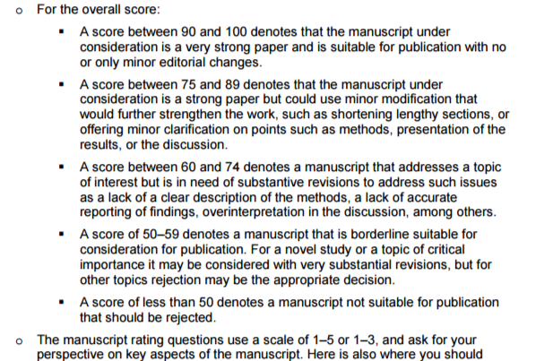
UDRUGA PRAVNIK
Pravnik
časopis za pravna i društvena pitanja
Trg maršala Tita 3
Zagreb
tel. 01 45 97 533
fax. 01 45 97 521
casopis@pravnik.hr
OBRAZAC ZA RECENZIJU
NAZIV RADA: _____________________________________________________________________
AUTOR RADA: _____________________________________________________________________
RECENZENT: ______________________________________________________________________
PODACI O RADU:
___________________________________________________________________________________
___________________________________________________________________________________
___________________________________________________________________________________
___________________________________________________________________________________
___________________________________________________________________________________
MIŠLJENJE RECENZENTA:
___________________________________________________________________________________
___________________________________________________________________________________
___________________________________________________________________________________
___________________________________________________________________________________
___________________________________________________________________________________
___________________________________________________________________________________
___________________________________________________________________________________
___________________________________________________________________________________
___________________________________________________________________________________
___________________________________________________________________________________
___________________________________________________________________________________
___________________________________________________________________________________
___________________________________________________________________________________
DATUM: POTPIS RECENZENTA:

Slide 39
Acknowledgment
University Computing Centre at University of Zagreb – HRČAK team (Draženko Celjak, Nino Katić, Miroslav Milinović)
HRČAK Advisory Board (Vesna Borić, Želimir Kurtanjek, Bono Lučić, Iva Melinščak Zlodi, Franjo Pehar, Mirjana Pejić Bach, Sanja Potkornjak, Aleksandar Zrnić, and Jadranka Stojanovski, chair)

Slide 40
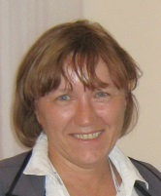
Thank you for your attention, comments and suggestions! ☺
J. Stojanovski – jadranka.stojanovski@irb.hr

